Slide 1
بسم الله الرحمن الرحیم

Slide 2
CMake
An extremely brief to introduction of CMake
سید سروش حسین‌علی‌پور

Slide 3
CMake
CMake is a collection of open-source and cross-platform tools used to build and distribute software.

Slide 4
History
CMake development began in 1999
Bill Hoffman
Pcmaker Ken Martin
Brad King

Slide 5
CMake is known as a meta build system.
It doesn't actually build your source code
instead, it generates native project files for the target platform

Slide 6
CMake builds build systems.
Notes:
For example, CMake on Windows will produce a solution for Visual Studio; CMake on Linux will produce a Makefile; CMake on macOS will produce a project for XCode and so on.

Slide 7
A project based on CMake always contains the CMakeLists.txt file
Generators
out-of-source build
Notes:
This special text file describes how the project is structured, the list of source files to compile, what CMake should generate out of it and so on.
Another nice CMake feature is the so-called out-of-source build. Any file required for the final build, executables included, will be stored in a separated build directory (usually called build/). This prevents cluttering up the source directory and makes it easy to start over again: just remove the build directory and you are done.

Slide 8
Understanding the CMakeLists.txt file
A modern CMake's CMakeLists.txt is a collection of targets and properties.
A target is a job of the building process. (desired outcome)
In our example, we want to build the source code into a binary executable: that's a target.
Targets have properties such as:
source files required to compile the executable
the compiler options
dependencies

Slide 9
In CMake you define targets and then add the necessary properties to them.

Slide 10
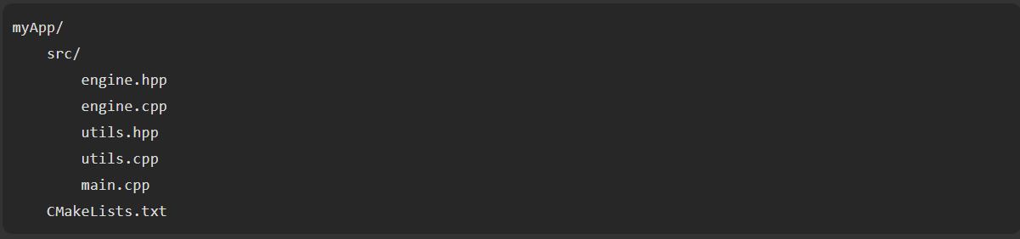

Slide 11
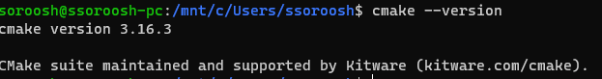
Define the CMake version
A CMakeLists.txt file always starts with the cmake_minimum_required() command
Modern CMake starts from version 3.0.0
We use

Slide 12
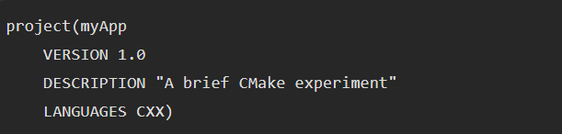
Set the project name
The second instruction a CMakeLists.txt file must contain is the project name
Notes:
where CXX stands for C++.
CXX and CPP are same with VC++, aparently the C++ source files were supposed to be .c++ but as few file systems dont allow + in extension, then it is said that x was used to mimic +, that how it became .cXX, not anyway different though.
Using the name CXX for C++ is quite popular because CPP usually designates the C (and C++) pre-processor.

Slide 13
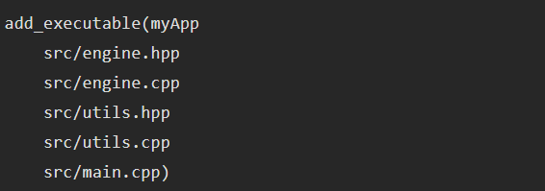
Define the executable target
We are about to add our first CMake target: the executable.
Notes:
CMake is smart enough to construct the filename according to the target platform conventions: myApp.exe on Windows, myApp on macOS and Linux and so on.

Slide 14
Set some target properties
They are set by a bunch of commands that start with the target_ suffix
These commands also require you to define the scope
how properties should propagate when you include the project into other CMake-based parent projects.
Since we are working on a binary executable (not a library), nobody will include it anywhere so we can stick to the default scope called PRIVATE

Slide 15
Some other properties
Notes:
The command will take care of adding the -D part for you if required, so no need for it.

Slide 16
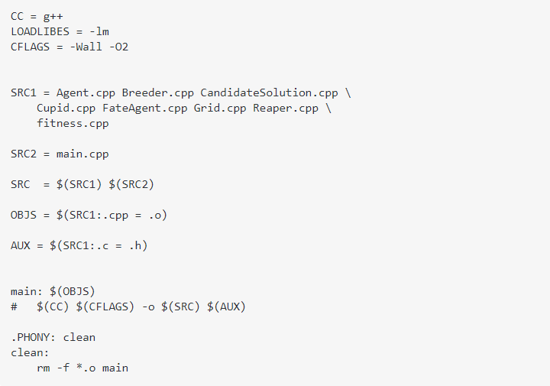

Slide 17
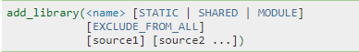
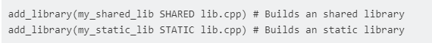
add_library
The CMake variable BUILD_SHARED_LIBS controls whenever to build an static (OFF) or an shared (ON) library

Slide 18
Running CMake to build the project
Notes:
Cmake ..

Slide 19
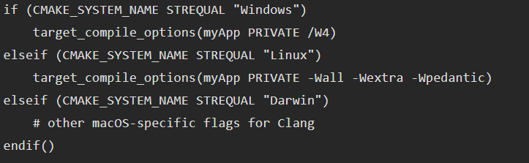
Add multiplatform support: Linux, Windows and macOS

Slide 20

Passing command line variables to CMake

Slide 21

Debug versus release builds
Debug — debugging information, no optimization;
Release — no debugging information and full optimization;
RelWithDebInfo — same as Release, but with debugging information;
MinSizeRel — a special Release build optimized for size.
multi-configuration generators
single-configuration generators

Slide 22
Dependency management

Slide 23

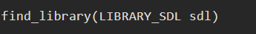
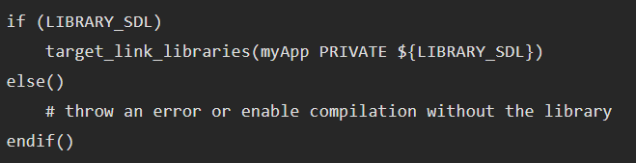
the find_library() command
The idea here is to instruct CMake to search the system for the required library and then link it to the executable if found.
it takes the name of the library to look for and a variable that will be filled with the library path, if found.
Notes:
Notice the use of the ${...} syntax to grab the variable content and use it as a command parameter.

Slide 24
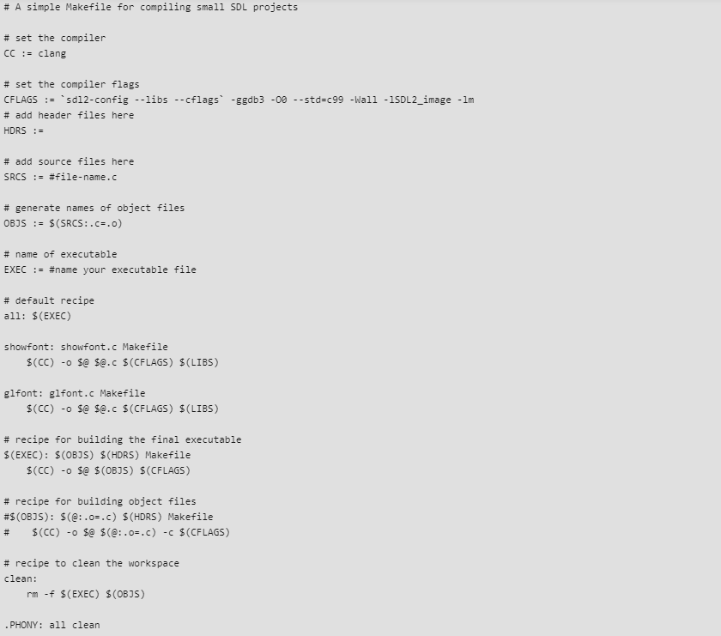

Slide 25
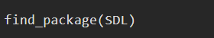
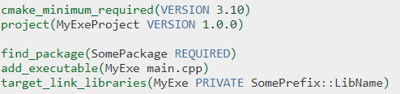
the find_package() command
You are using special CMake modules that help in finding various well-known libraries and packages.
Such modules are provided by the library authors
cmake --help-module-list
Modules that start with the Find suffix are used by the find_package()
Notes:
https://bastian.rieck.me/blog/posts/2018/cmake_tips/

Slide 26
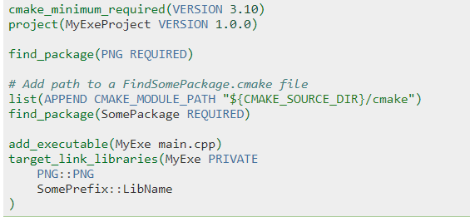

Slide 27
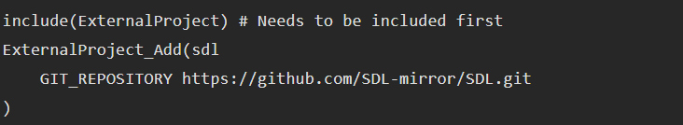
the ExternalProject module
it downloads, builds and prepares the library for use in your CMake project
By default it assumes the dependency to be a CMake project but you can easily pass custom build instructions if necessary.
Using this module is about calling the ExternalProject_Add(<name> [<option>...]) command
One thing to keep in mind: the download step is performed when you build the project
Notes:
The two previous commands assume the library is already available and compiled somewhere in your system. The ExternalProject module follows a different approach:
One thing to keep in mind: the download step is performed when you build the project (e.g. when invoking make on Linux), so CMake is not aware of the library presence while it generates the project (e.g. when you invoke the cmake command). The consequence is that you can't obtain the right path and flags for your library with commands like find_library() or find_package(). One way is to assume that the dependency is already in place because it will be downloaded and built sooner or later, so you just pass its full path to target_link_libraries() instead of a variable as we did before.

Slide 28
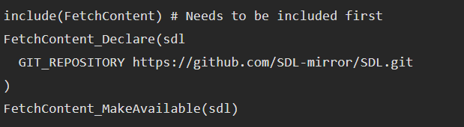
the FetchContent module (CMake 3.14+)
The difference here is that FetchContent downloads the source code in advance while generating the project.
This lets CMake know that the dependency exists and to treat it as a child project.

Slide 29
